Slide 1
Technin 510 Week 3
Image Processing
10/13/21

Slide 2
Today
Basics of Image Processing
Technin510 S3 What is ML
Lunch
Technin510 L3 Image Processing

Slide 3
Notes on Lab 1
Make your Colab notebook publicly accessible
Include link to Colab AND .ipynb file on Canvas
Make sure your notebook will run w/o error by another user!
Keep an eye on comments in the assignment portal

Slide 4
Filtering
Edge detection
Feature detection
Object detection
Image classification
Image Processing

Slide 5
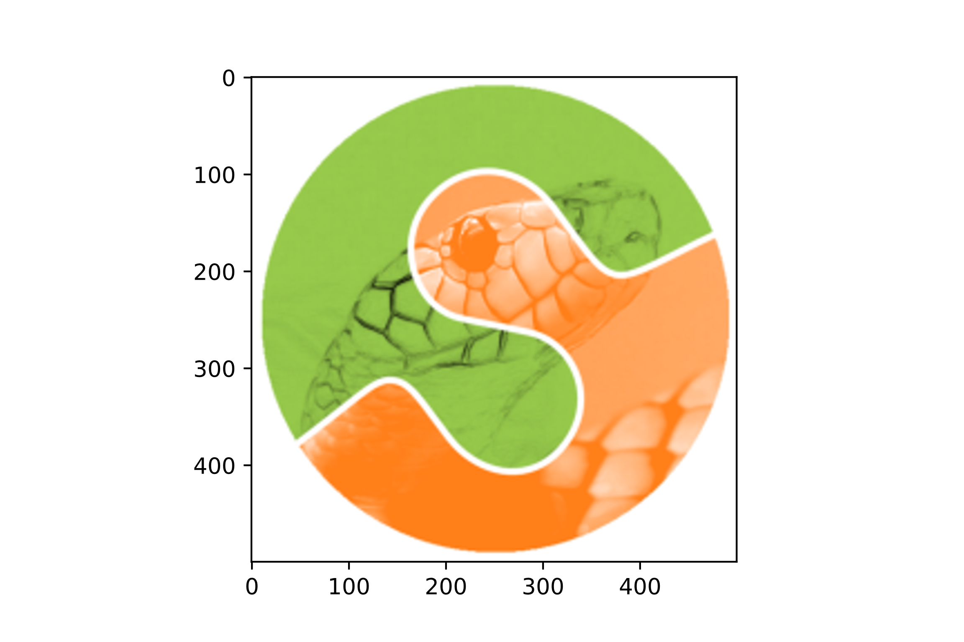
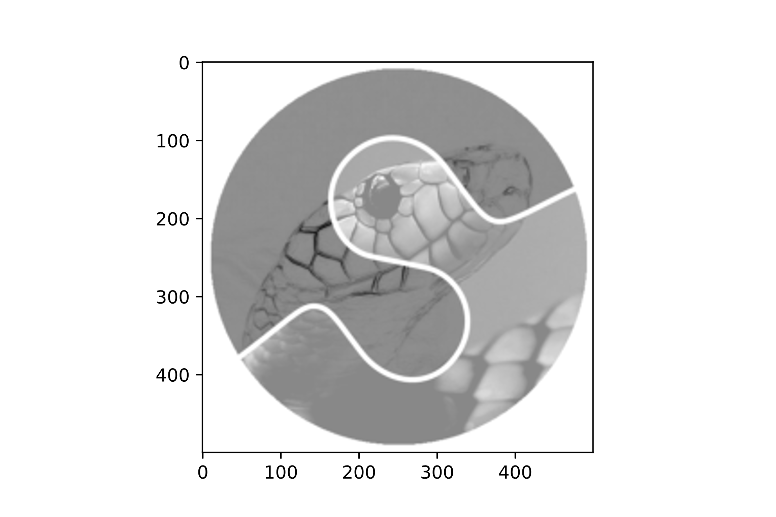
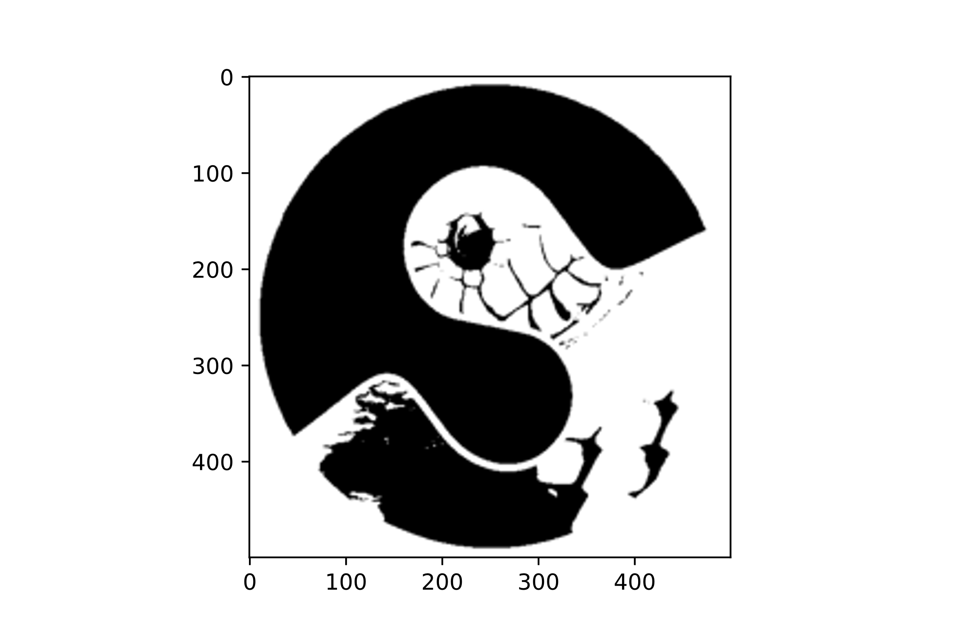
Images as Arrays

Slide 6
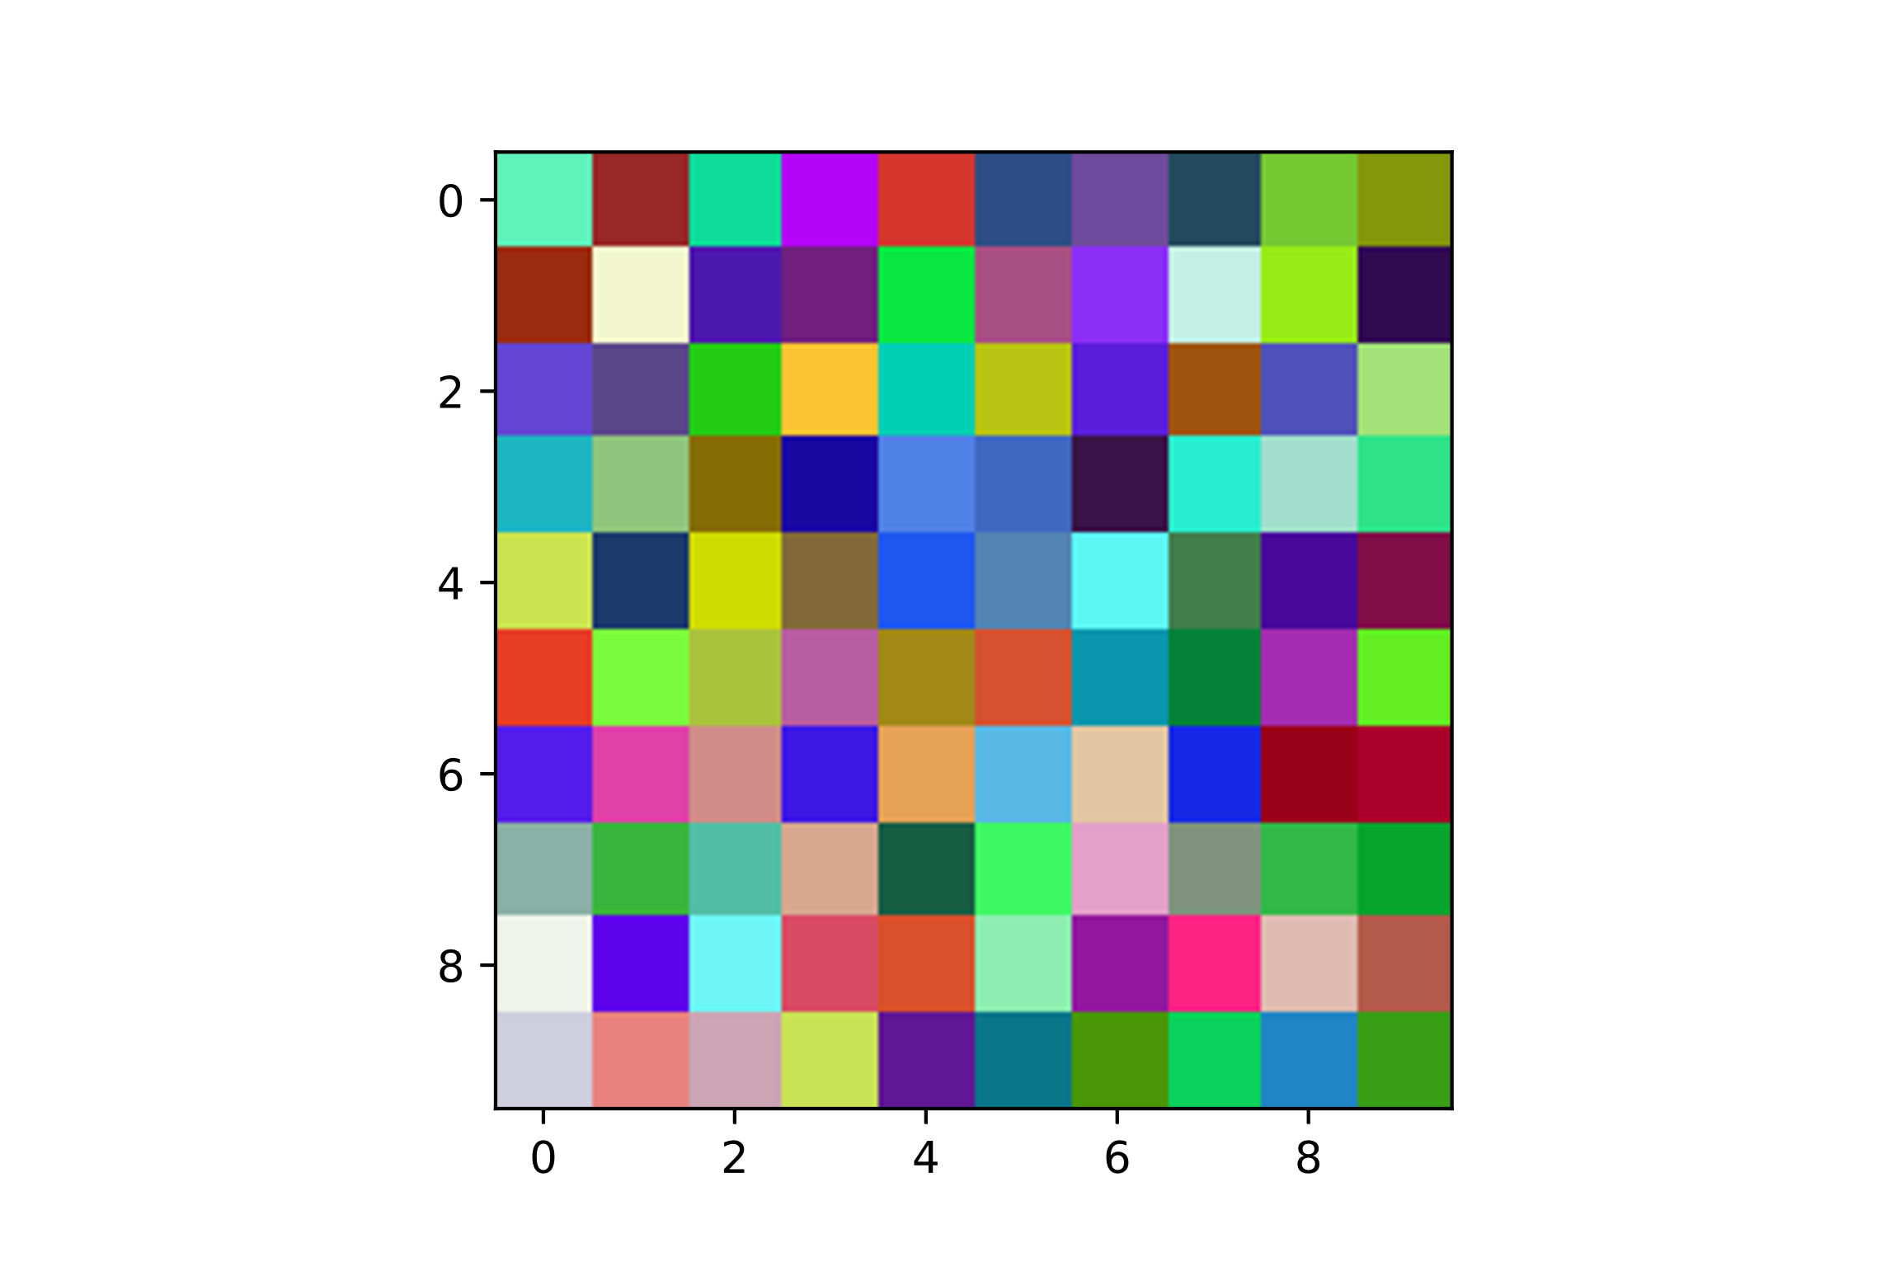
Images as Arrays
186 | 39 | 153 | 247 | 46 | 133 | 156 | 93 | 50 | 11
16 | 206 | 174 | 126 | 65 | 132 | 247 | 228 | 22 | 82
211 | 138 | 19 | 50 | 180 | 18 | 220 | 16 | 186 | 120
194 | 125 | 6 | 162 | 231 | 192 | 73 | 206 | 204 | 137
81 | 108 | 1 | 56 | 240 | 179 | 245 | 76 | 155 | 71
36 | 61 | 60 | 161 | 23 | 47 | 172 | 57 | 176 | 35
235 | 168 | 135 | 228 | 86 | 228 | 163 | 229 | 25 | 41
166 | 60 | 165 | 144 | 67 | 100 | 202 | 125 | 71 | 45
233 | 236 | 245 | 98 | 43 | 177 | 156 | 132 | 177 | 74
221 | 127 | 179 | 86 | 147 | 138 | 7 | 91 | 196 | 21
242 | 39 | 220 | 5 | 54 | 77 | 74 | 74 | 200 | 151
43 | 246 | 24 | 31 | 231 | 79 | 47 | 239 | 235 | 11
69 | 71 | 204 | 196 | 207 | 196 | 29 | 84 | 82 | 226
181 | 196 | 109 | 8 | 129 | 104 | 19 | 237 | 222 | 227
228 | 58 | 219 | 106 | 86 | 132 | 247 | 126 | 9 | 13
61 | 251 | 194 | 93 | 136 | 81 | 150 | 130 | 44 | 238
28 | 65 | 141 | 23 | 161 | 185 | 198 | 41 | 2 | 1
176 | 181 | 190 | 167 | 93 | 248 | 160 | 147 | 184 | 164
243 | 3 | 246 | 75 | 80 | 238 | 24 | 35 | 188 | 91
206 | 130 | 165 | 226 | 23 | 118 | 150 | 209 | 133 | 158
95 | 152 | 14 | 180 | 212 | 46 | 110 | 35 | 116 | 131
154 | 241 | 77 | 112 | 8 | 168 | 139 | 197 | 152 | 49
99 | 90 | 35 | 251 | 1 | 185 | 91 | 158 | 79 | 162
30 | 143 | 133 | 27 | 80 | 63 | 58 | 41 | 161 | 47
205 | 28 | 208 | 130 | 30 | 82 | 92 | 64 | 72 | 128
231 | 124 | 171 | 185 | 161 | 213 | 10 | 4 | 164 | 98
86 | 223 | 208 | 61 | 229 | 89 | 226 | 21 | 154 | 169
139 | 57 | 82 | 216 | 23 | 62 | 227 | 128 | 49 | 6
239 | 94 | 109 | 217 | 217 | 141 | 145 | 252 | 223 | 179
206 | 232 | 203 | 202 | 95 | 9 | 73 | 9 | 32 | 55

Slide 7
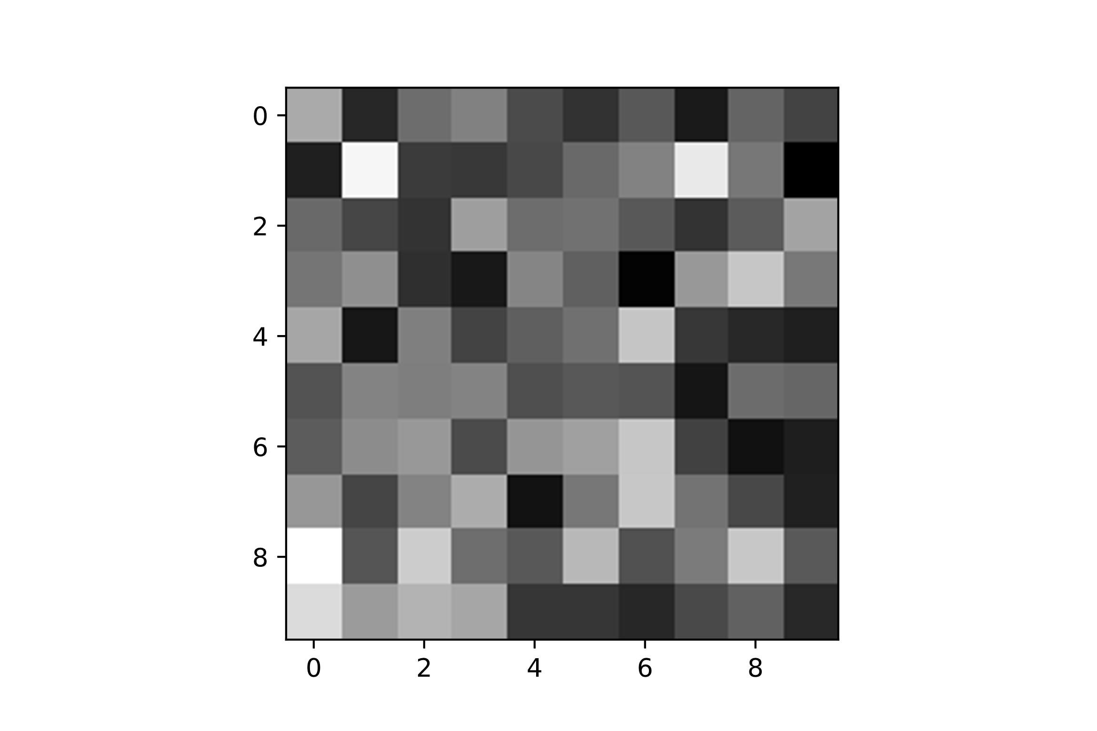
Images as Arrays
174 | 76 | 129 | 144 | 104 | 85 | 113 | 67 | 122 | 97
71 | 231 | 91 | 89 | 101 | 126 | 144 | 221 | 136 | 47
126 | 99 | 86 | 165 | 129 | 133 | 113 | 86 | 115 | 169
135 | 154 | 82 | 65 | 146 | 119 | 50 | 161 | 195 | 137
171 | 64 | 142 | 97 | 118 | 131 | 194 | 88 | 78 | 70
109 | 145 | 141 | 146 | 106 | 113 | 110 | 63 | 128 | 123
116 | 152 | 161 | 104 | 158 | 167 | 195 | 97 | 60 | 70
160 | 99 | 145 | 175 | 61 | 136 | 196 | 133 | 101 | 71
238 | 111 | 200 | 130 | 113 | 185 | 108 | 139 | 196 | 114
211 | 163 | 182 | 171 | 88 | 88 | 76 | 103 | 120 | 78

Slide 8
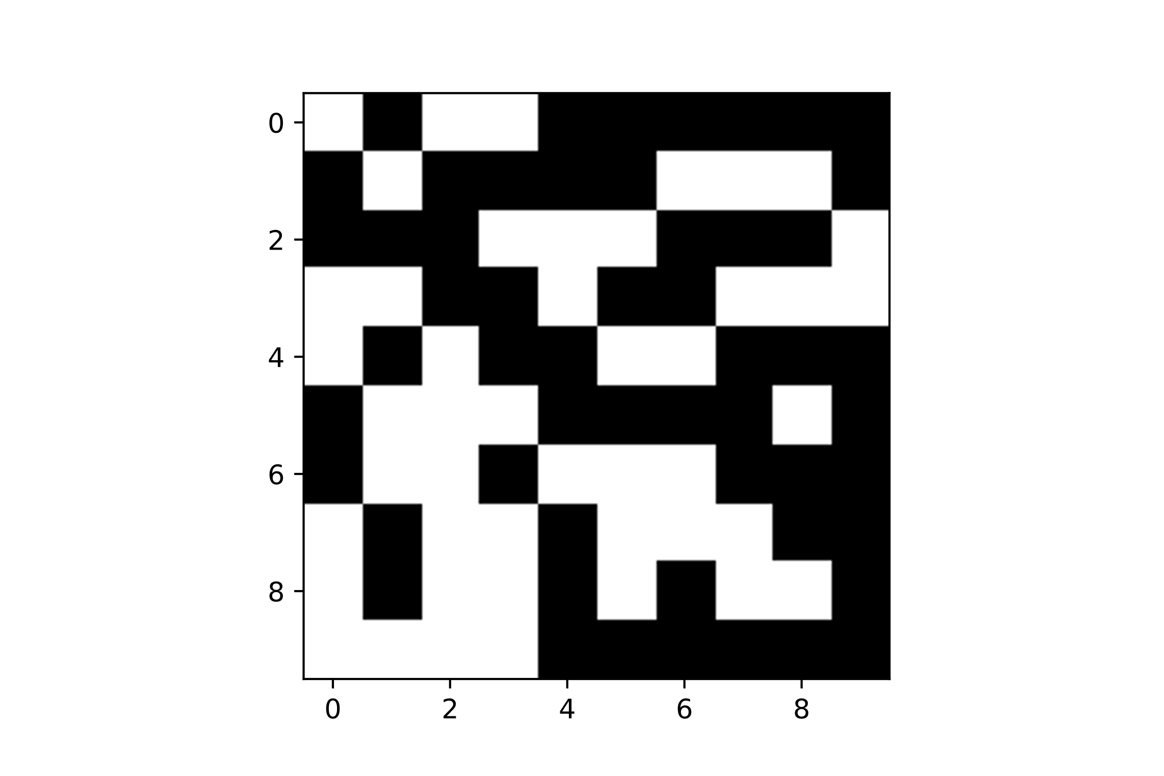
Images as Arrays
255 | 0 | 255 | 255 | 0 | 0 | 0 | 0 | 0 | 0
0 | 255 | 0 | 0 | 0 | 0 | 255 | 255 | 255 | 0
0 | 0 | 0 | 255 | 255 | 255 | 0 | 0 | 0 | 255
255 | 255 | 0 | 0 | 255 | 0 | 0 | 255 | 255 | 255
255 | 0 | 255 | 0 | 0 | 255 | 255 | 0 | 0 | 0
0 | 255 | 255 | 255 | 0 | 0 | 0 | 0 | 255 | 0
0 | 255 | 255 | 0 | 255 | 255 | 255 | 0 | 0 | 0
255 | 0 | 255 | 255 | 0 | 255 | 255 | 255 | 0 | 0
255 | 0 | 255 | 255 | 0 | 255 | 0 | 255 | 255 | 0
255 | 255 | 255 | 255 | 0 | 0 | 0 | 0 | 0 | 0

Slide 9
Noise removal
Edge detection
Texture description
Multi-scale algorithms
Feature detection
…
Image Filtering

Slide 10
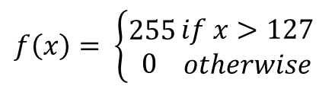
Monadic Operators: Thresholding
174 | 76 | 129 | 144 | 104 | 85 | 113 | 67 | 122 | 97
71 | 231 | 91 | 89 | 101 | 126 | 144 | 221 | 136 | 47
126 | 99 | 86 | 165 | 129 | 133 | 113 | 86 | 115 | 169
135 | 154 | 82 | 65 | 146 | 119 | 50 | 161 | 195 | 137
171 | 64 | 142 | 97 | 118 | 131 | 194 | 88 | 78 | 70
109 | 145 | 141 | 146 | 106 | 113 | 110 | 63 | 128 | 123
116 | 152 | 161 | 104 | 158 | 167 | 195 | 97 | 60 | 70
160 | 99 | 145 | 175 | 61 | 136 | 196 | 133 | 101 | 71
238 | 111 | 200 | 130 | 113 | 185 | 108 | 139 | 196 | 114
211 | 163 | 182 | 171 | 88 | 88 | 76 | 103 | 120 | 78
$$f\left(x\right)= \left\{\begin{aligned}255 \\ 0 \end{aligned}\right.\begin{matrix}if x>127 \\ otherwise\end{matrix}$$
255 | 0 | 255 | 255 | 0 | 0 | 0 | 0 | 0 | 0
0 | 255 | 0 | 0 | 0 | 0 | 255 | 255 | 255 | 0
0 | 0 | 0 | 255 | 255 | 255 | 0 | 0 | 0 | 255
255 | 255 | 0 | 0 | 255 | 0 | 0 | 255 | 255 | 255
255 | 0 | 255 | 0 | 0 | 255 | 255 | 0 | 0 | 0
0 | 255 | 255 | 255 | 0 | 0 | 0 | 0 | 255 | 0
0 | 255 | 255 | 0 | 255 | 255 | 255 | 0 | 0 | 0
255 | 0 | 255 | 255 | 0 | 255 | 255 | 255 | 0 | 0
255 | 0 | 255 | 255 | 0 | 255 | 0 | 255 | 255 | 0
255 | 255 | 255 | 255 | 0 | 0 | 0 | 0 | 0 | 0
Monadic image processing
operations. Each output pixel is a function of the corresponding input pixel (shown in purple)

Slide 11
Monadic Operators: Thresholding
$$f\left(x\right)= \left\{\begin{aligned}255 \\ 0 \end{aligned}\right.\begin{matrix}if x>127 \\ otherwise\end{matrix}$$
Monadic image processing
operations. Each output pixel is a function of the corresponding input pixel

Slide 12
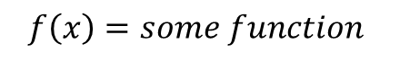
Local Operators: Image filtering
Modify the pixels in an image based on some function of a local neighborhood
174 | 76 | 129 | 144 | 104 | 85 | 113 | 67 | 122 | 97
71 | 231 | 91 | 89 | 101 | 126 | 144 | 221 | 136 | 47
126 | 99 | 86 | 165 | 129 | 133 | 113 | 86 | 115 | 169
135 | 154 | 82 | 65 | 146 | 119 | 50 | 161 | 195 | 137
171 | 64 | 142 | 97 | 118 | 131 | 194 | 88 | 78 | 70
109 | 145 | 141 | 146 | 106 | 113 | 110 | 63 | 128 | 123
116 | 152 | 161 | 104 | 158 | 167 | 195 | 97 | 60 | 70
160 | 99 | 145 | 175 | 61 | 136 | 196 | 133 | 101 | 71
238 | 111 | 200 | 130 | 113 | 185 | 108 | 139 | 196 | 114
211 | 163 | 182 | 171 | 88 | 88 | 76 | 103 | 120 | 78
255 | 0 | 255 | 255 | 0 | 0 | 0 | 0 | 0 | 0
0 | 255 | 0 | 0 | 0 | 0 | 255 | 255 | 255 | 0
0 | 0 | 0 | 255 | 255 | 255 | 0 | 0 | 0 | 255
255 | 255 | 0 | 0 | 255 | 0 | 0 | 255 | 255 | 255
255 | 0 | 255 | 0 | 0 | 255 | 255 | 0 | 0 | 0
0 | 255 | 255 | 255 | 0 | 0 | 0 | 0 | 255 | 0
0 | 255 | 255 | 0 | 255 | 255 | 255 | 0 | 0 | 0
255 | 0 | 255 | 255 | 0 | 255 | 255 | 255 | 0 | 0
255 | 0 | 255 | 255 | 0 | 255 | 0 | 255 | 255 | 0
255 | 255 | 255 | 255 | 0 | 0 | 0 | 0 | 0 | 0
$$f\left(x\right)=some function$$
Local image processing operations. The grey region on the left shows the window, W, that is the set of pixels used to compute the purple output pixel on the right

Slide 13

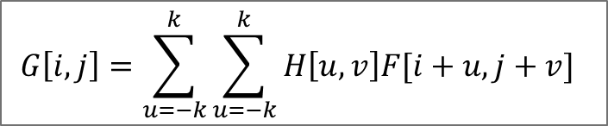

Local Operators: Linear filtering
Replace each pixel by a linear combination of its neighbors
Let F be the image, H be the kernel and G be the output image
$$G\left[i,j\right]=\sum_{u=−k}^{k}{\sum_{u=−k}^{k}{H\left[u,v\right]F[i+u,j+v]}}$$
174 | 76 | 129 | 144 | 104 | 85 | 113 | 67 | 122 | 97
71 | 231 | 91 | 89 | 101 | 126 | 144 | 221 | 136 | 47
126 | 99 | 86 | 165 | 129 | 133 | 113 | 86 | 115 | 169
135 | 154 | 82 | 65 | 146 | 119 | 50 | 161 | 195 | 137
171 | 64 | 142 | 97 | 118 | 131 | 194 | 88 | 78 | 70
109 | 145 | 141 | 146 | 106 | 113 | 110 | 63 | 128 | 123
116 | 152 | 161 | 104 | 158 | 167 | 195 | 97 | 60 | 70
160 | 99 | 145 | 175 | 61 | 136 | 196 | 133 | 101 | 71
238 | 111 | 200 | 130 | 113 | 185 | 108 | 139 | 196 | 114
211 | 163 | 182 | 171 | 88 | 88 | 76 | 103 | 120 | 78
$$i$$
0 | 0 | 0 | 0 | 0 | 0 | 0 | 0 | 0 | 0
0 | 61 | 58 | 50 | 48 | 46 | 52 | 60 | 60 | 0
0 | 58 | 56 | 47 | 53 | 54 | 57 | 62 | 62 | 0
0 | 57 | 46 | 44 | 56 | 58 | 46 | 45 | 61 | 0
0 | 58 | 49 | 42 | 47 | 57 | 54 | 54 | 58 | 0
0 | 54 | 54 | 58 | 51 | 52 | 60 | 50 | 39 | 0
0 | 58 | 66 | 61 | 57 | 60 | 65 | 51 | 38 | 0
0 | 58 | 61 | 65 | 55 | 58 | 77 | 69 | 43 | 0
0 | 67 | 61 | 72 | 53 | 55 | 69 | 64 | 63 | 0
0 | 0 | 0 | 0 | 0 | 0 | 0 | 0 | 0 | 0
1 | 1 | 1
1 | 1 | 1
1 | 1 | 1
$$\frac{1}{9}$$
Notes:
Common to use 8bit (255 = white, 0 = black)

Slide 14
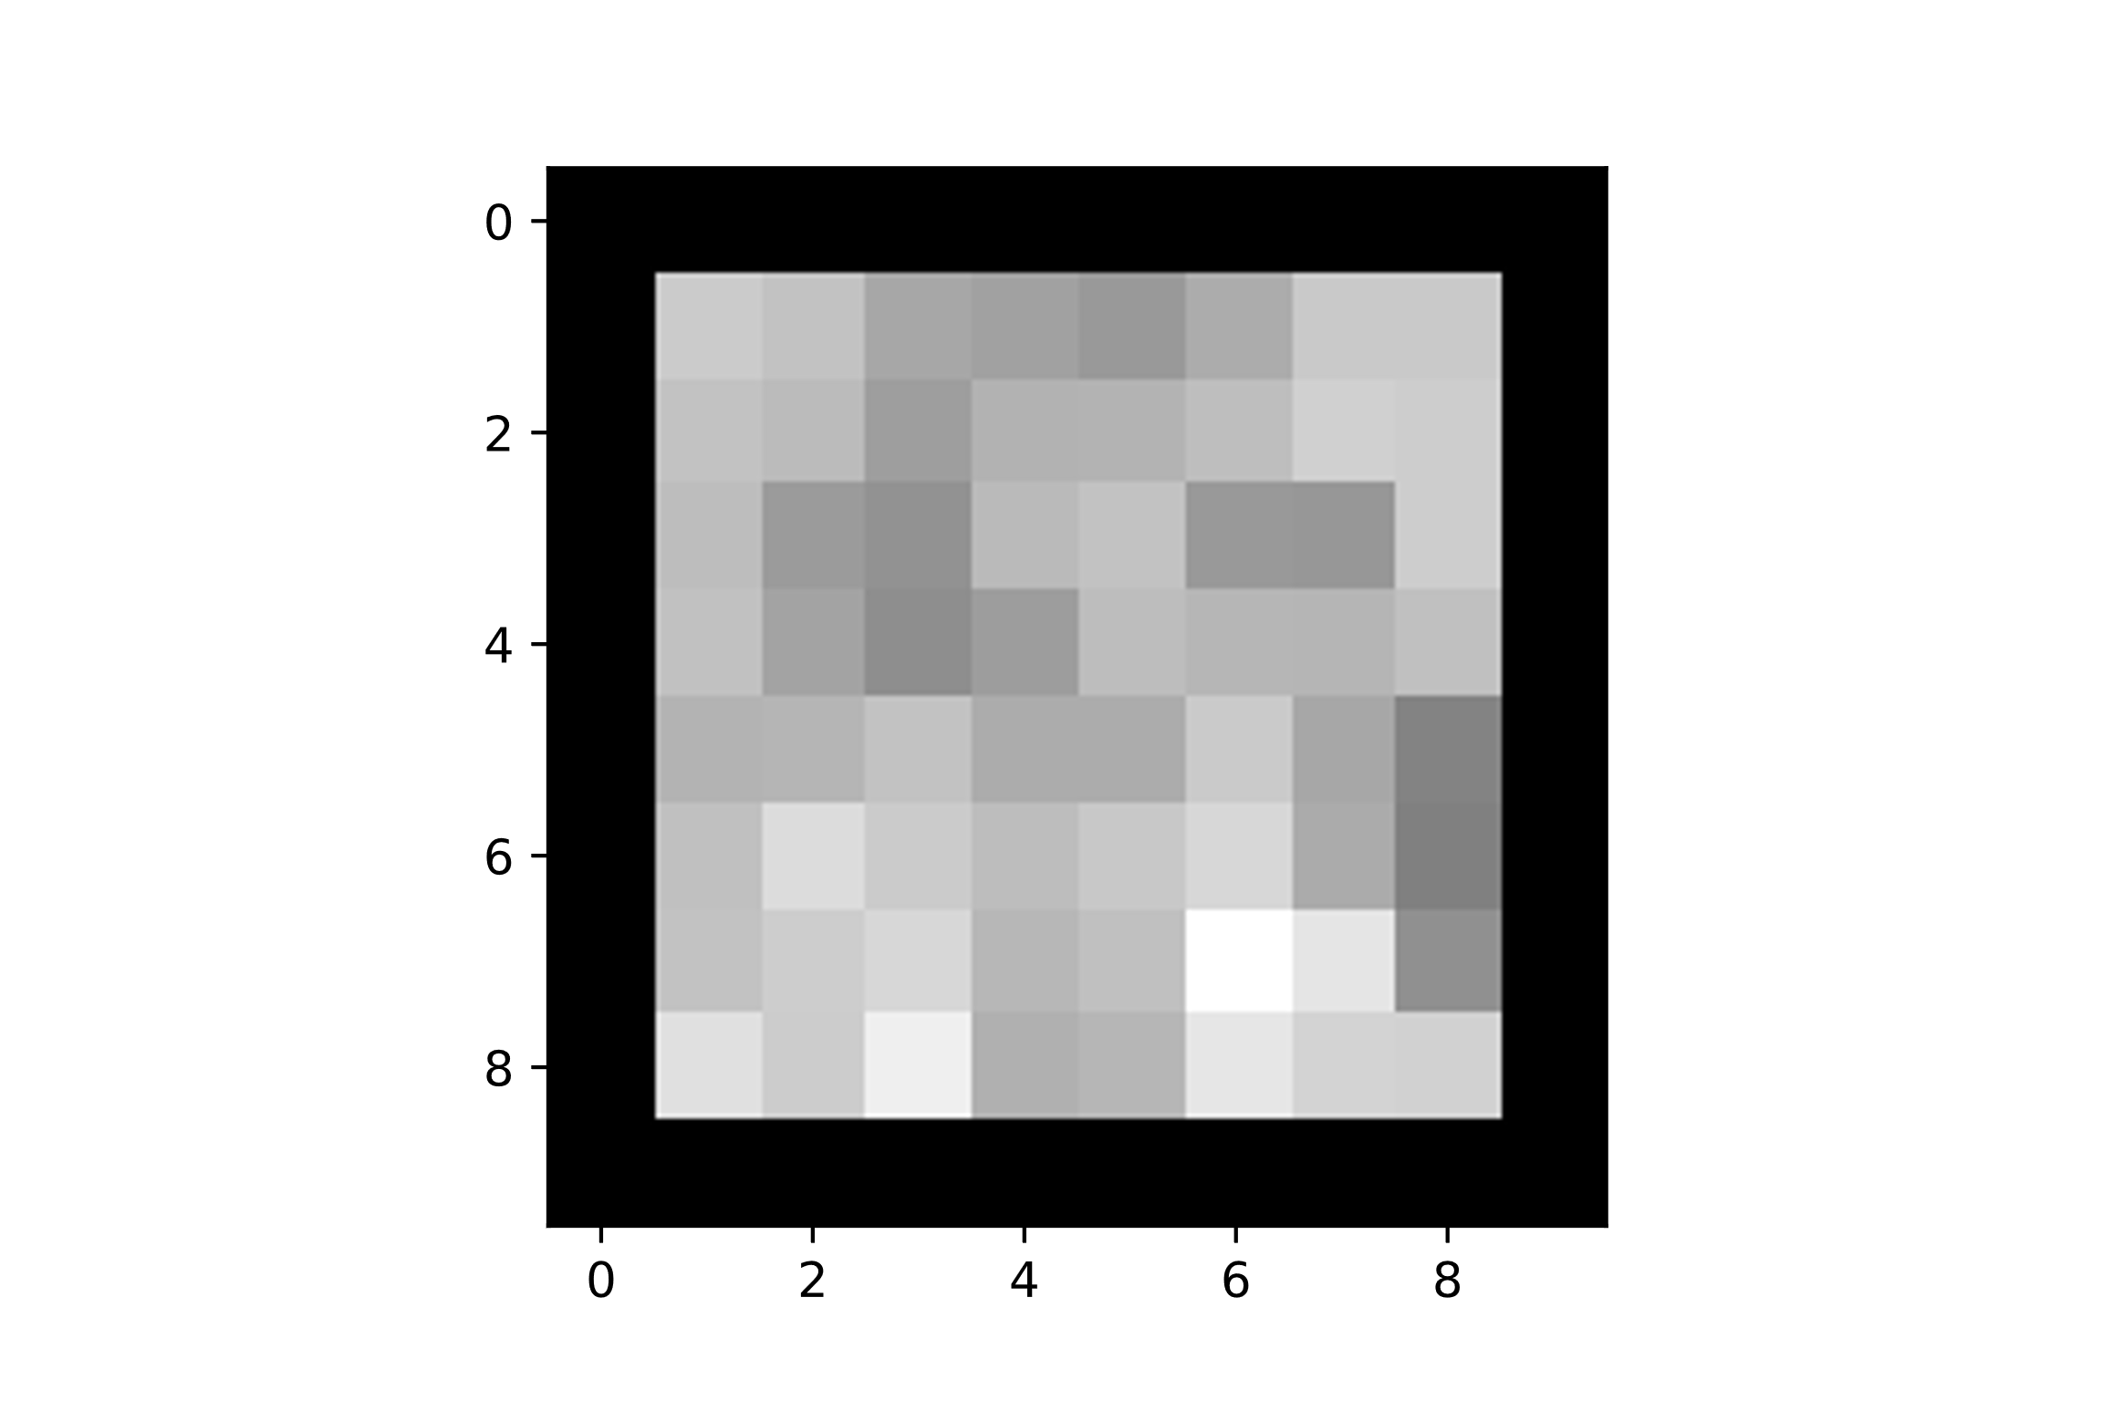
Local Operators: Linear filtering
Applying a kernel to an image in this way is called a convolution
$$G\left[i,j\right]=\sum_{u=−k}^{k}{\sum_{u=−k}^{k}{H\left[u,v\right]F[i+u,j+v]}}$$
$$i$$
1 | 1 | 1
1 | 1 | 1
1 | 1 | 1
$$\frac{1}{9}$$
Notes:
Common to use 8bit (255 = white, 0 = black)

Slide 15
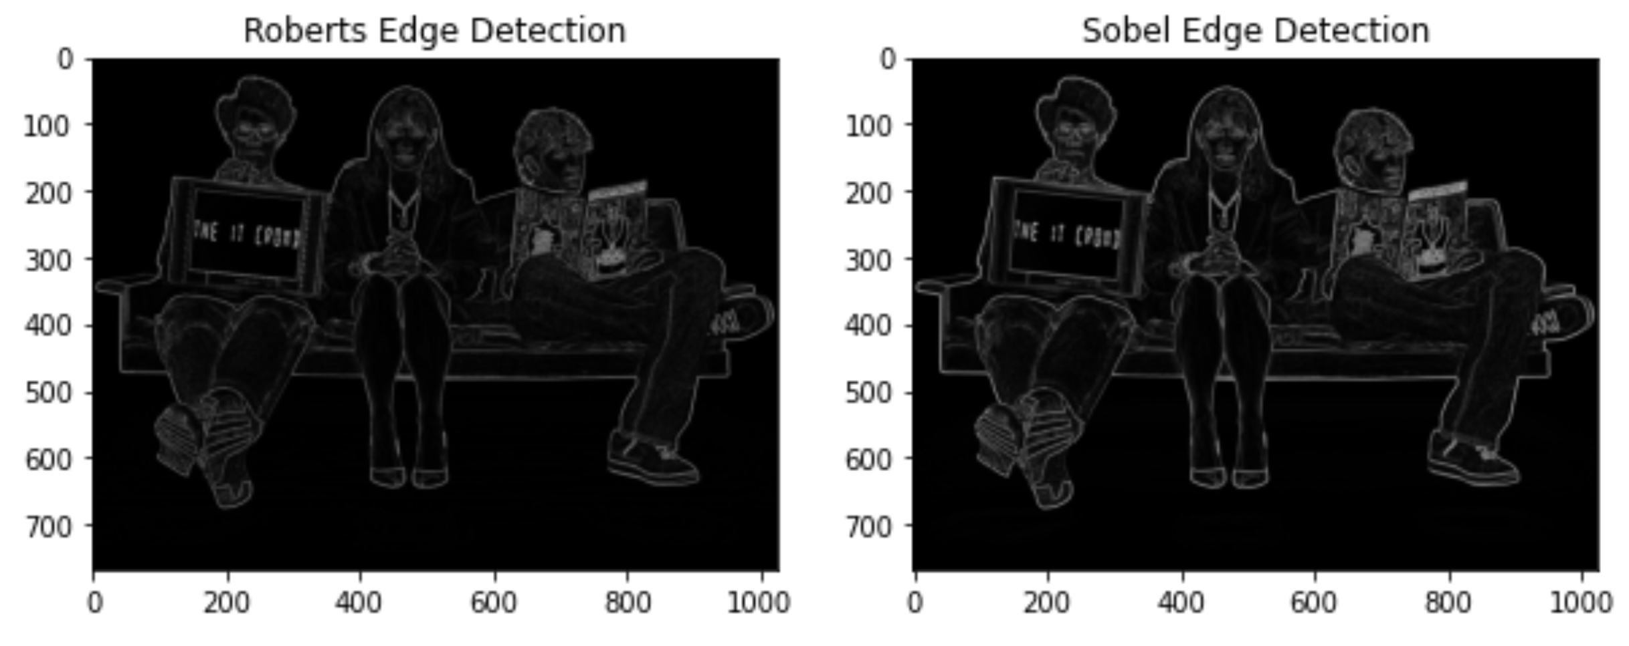
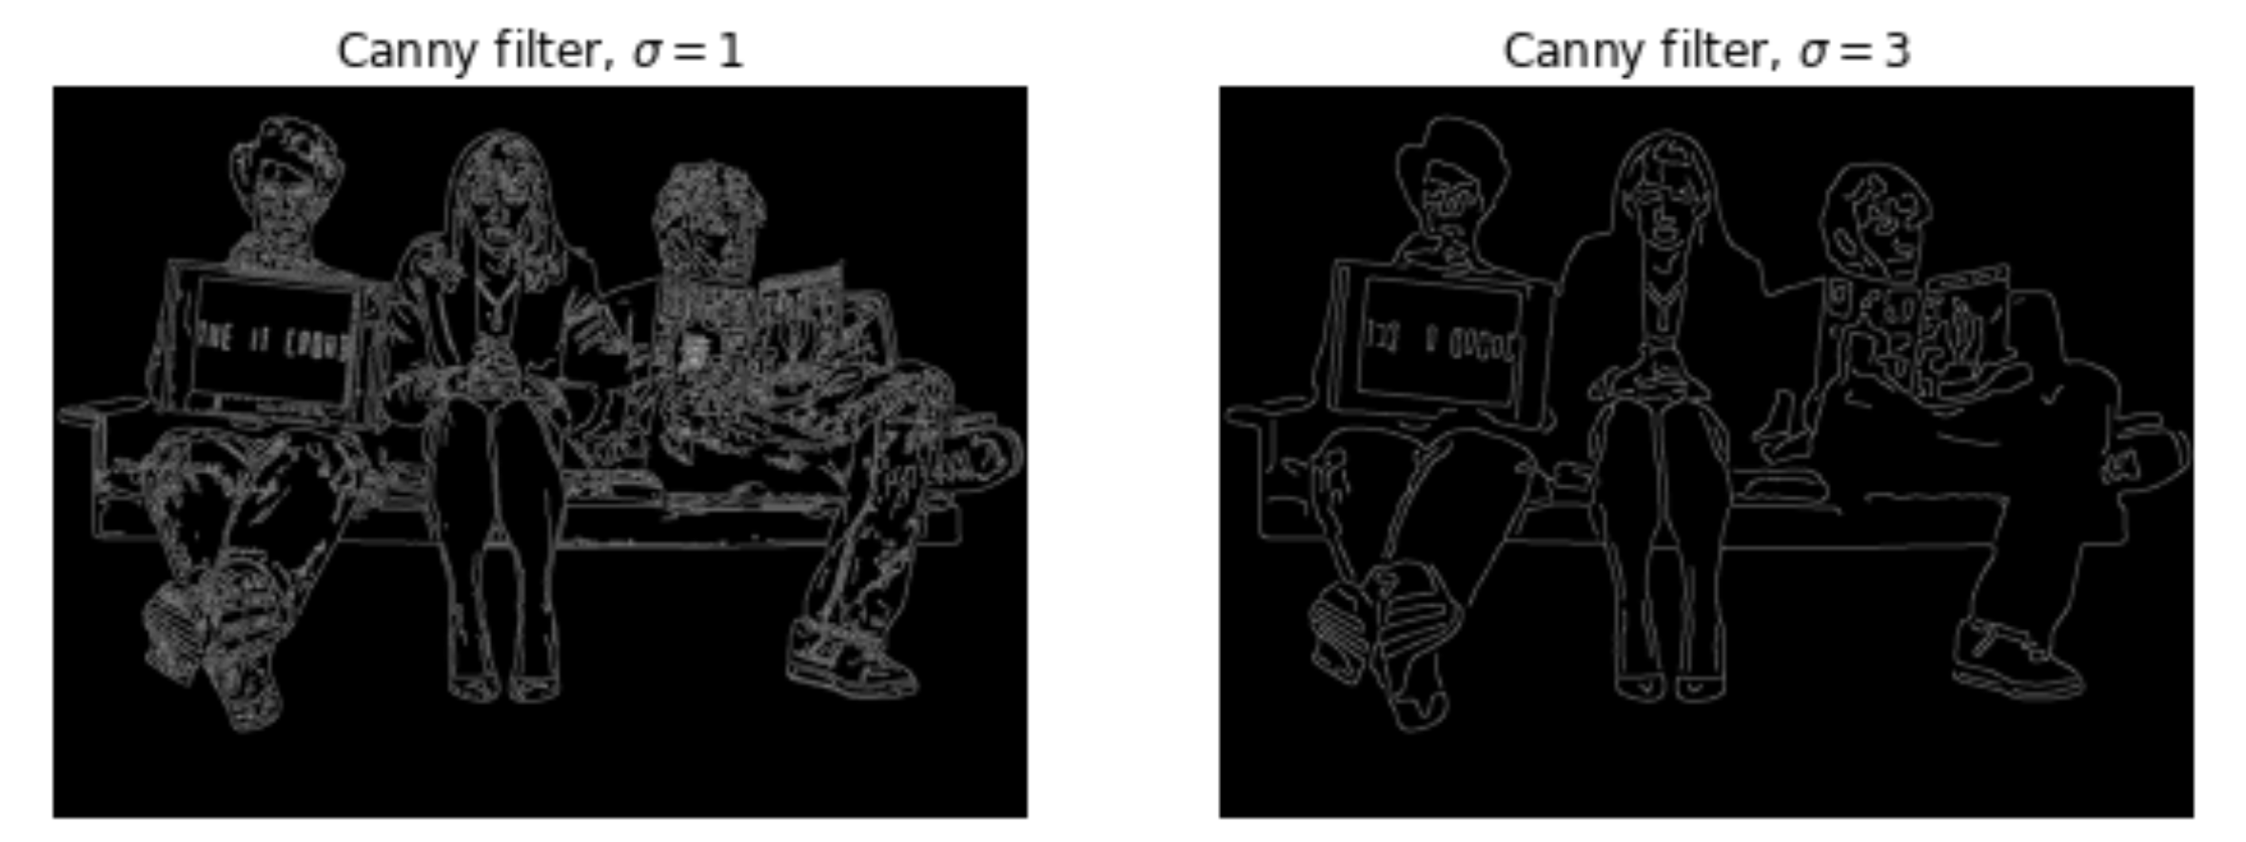
Edge Detection
Characterized as a place of rapid change in the image intensity
Methods
Through convolution
Sobel
Prewitt
Roberts
Multi-scale algorithm
Canny
Uses gaussian filter and intensity gradient

